Slide 1
Comparison of Toronto and Vancouver Neighborhoods
Daniel Easley
September 29, 2019

Slide 2
Predicting the Chinese immigration impact on Vancouver is important for the Restaurant industry
Can we determine a shift in the restaurant venues, impacted by the Chinese immigration?
The 1997 handover of Hong Kong back to China, has caused a surge of Chinese immigration
The Global Livability Ranking study selected Vancouver as 6th and Toronto as 7th
The cities are 2090 miles (3364 km) apart

Slide 3
Data Acquisition and preparation
The livability rankings can be found at Global Livability Ranking
Population and Ethnic Diversity, based on the 2016 Canadian census for Toronto and Vancouver
Postal codes will be scraped from the wikis: Toronto and Vancouver
Geocoder will use ArcGis for neighborhood coordinates
All venue information will be sourced from the Foursquare REST API
Toronto will have 1748 venues and 210 distinct venue categories
Vancouver will have 854 venues and 187 distinct venue categories

Slide 4
City Comparison
City | Location | Population (2016 census) | Ethnic Diversity (2016 census)
Vancouver | British Columbia (Pacific Time Zone) | 631,486 | 48.9% European (white) 19.6% Chinese 12.0% South Asian
Toronto | Ontario (Eastern Time Zone) | 2,731,571 | 47.7% European (white) 12.6% South Asian 11.1% Chinese

Slide 5
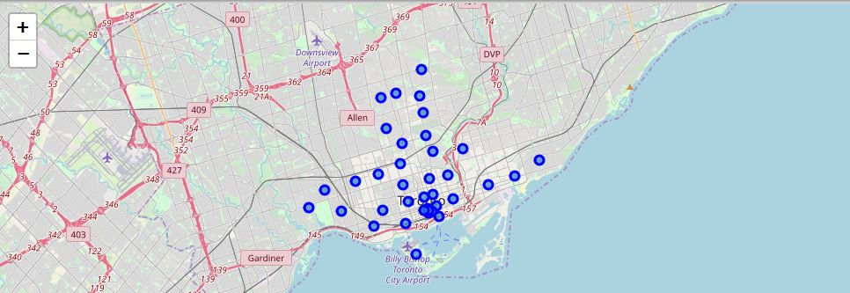
Toronto Postal Codes

Slide 6
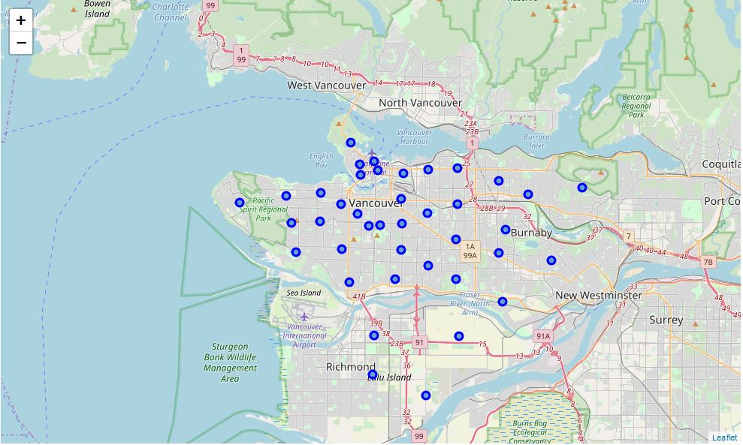
Vancouver Postal Codes

Slide 7
Unique Vancouver venues
Australian Restaurant
Cantonese Restaurant
Filipino Restaurant
Hawaiian Restaurant
Himalayan Restaurant
Japanese Curry Restaurant
Kosher Restaurant
Lebanese Restaurant
Portuguese Restaurant
Shanghai Restaurant
South Indian Restaurant

Slide 8
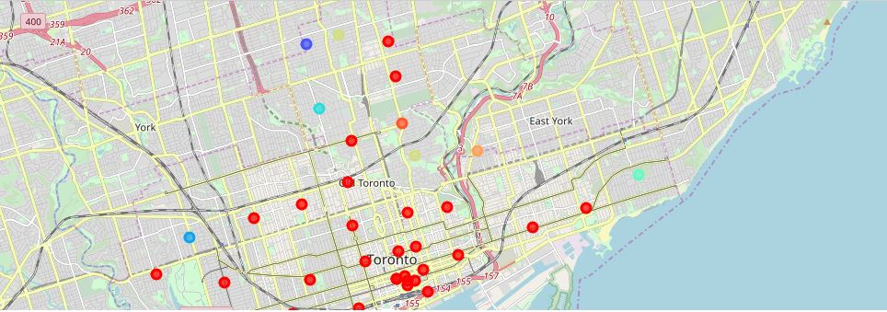
Toronto Clusters

Slide 9
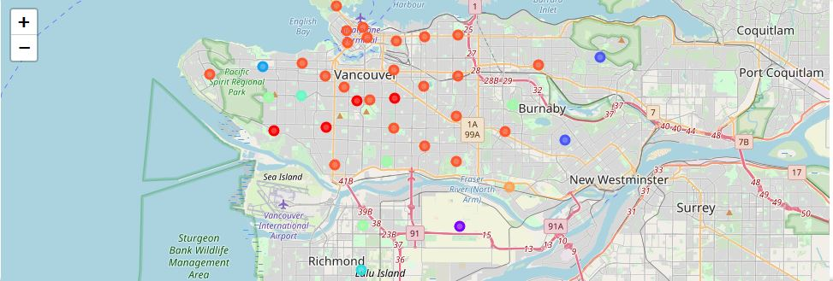
Vancouver Clusters

Slide 10
Conclusions
Reviewing the largest cluster for each city, we find that these clusters contain many restaurant locations. To compare these clusters, I then focused on the top 4 venues for each cluster to see if they contained a ‘Chinese Restaurant’.
Toronto
Postal codes within the cluster: 28 Boroughs that have 'Chinese Restaurant' in the top 4 most common venues: 0
Vancouver
Postal codes within the cluster: 23 Boroughs that have 'Chinese Restaurant' in the top 4 most common venues: 7
Based on these results we can say that the Chinese immigration has heavily affected the restaurant venues in Vancouver. The restaurant industry in Vancouver should shift their product mix towards the Chinese market.

